Slide 1
Predicting Sentiment Toward Birth Control Methods
A project to help Pfizer learn from the online conversation about birth control methods
Aaron Galbraith • 2023

Slide 2
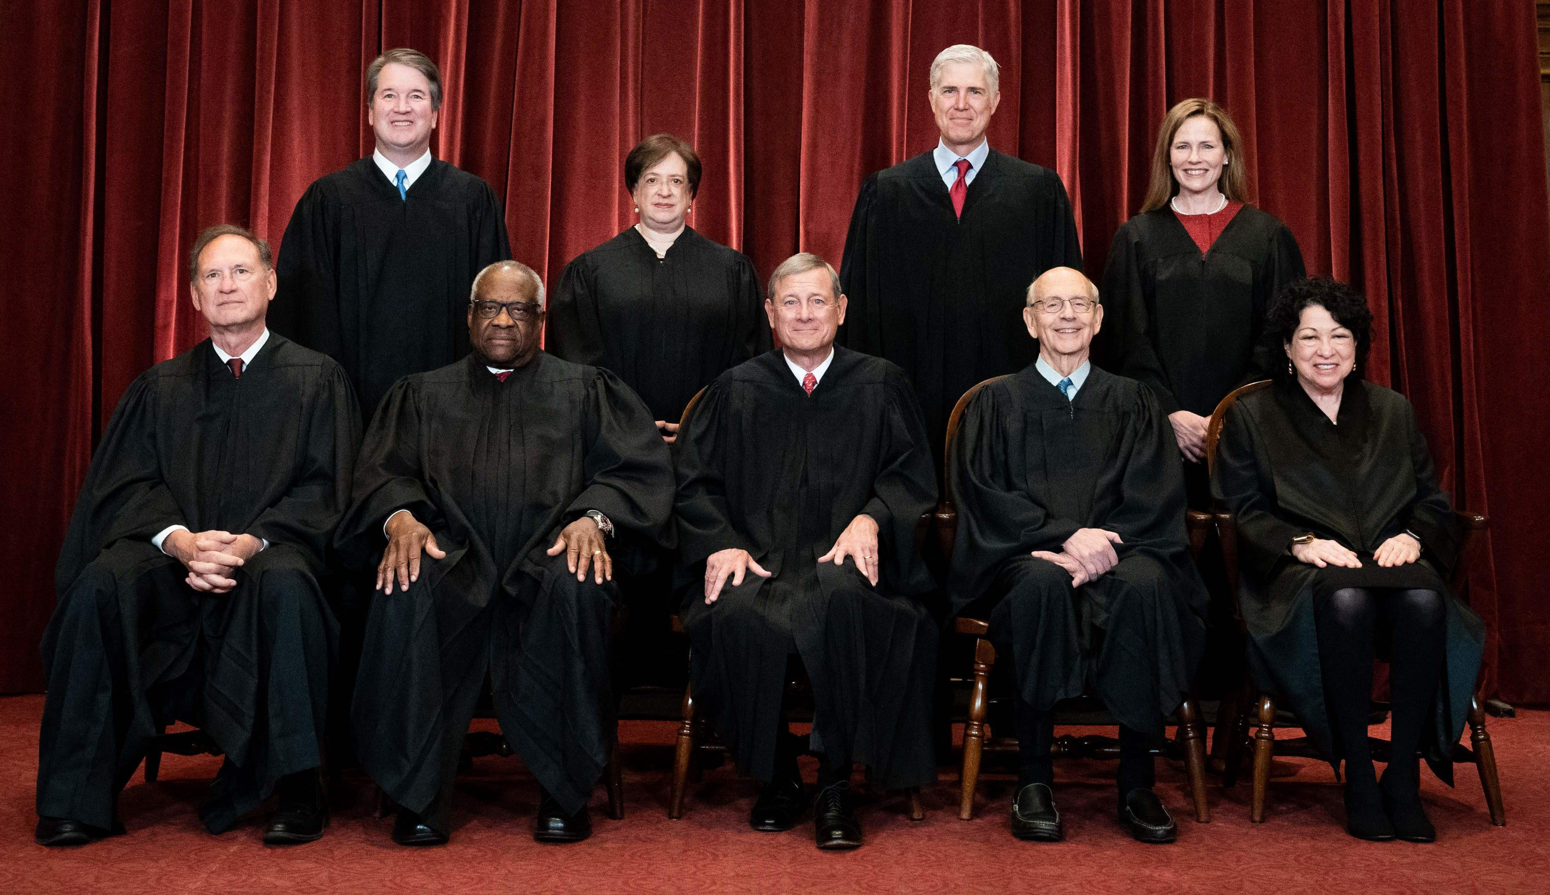


Background
2022 Dobbs ruling
reproductive health conversations
Pfizer

Slide 3
Project Goal
to help Pfizer understand public sentiment toward various birth control methods in order to develop and market their products accordingly

Slide 4
Data
~20,000 reviews from 2008-2017
acquired from drugs.com by researchers at UC Irvine
1-10 rating
7 different birth control methods

Slide 5
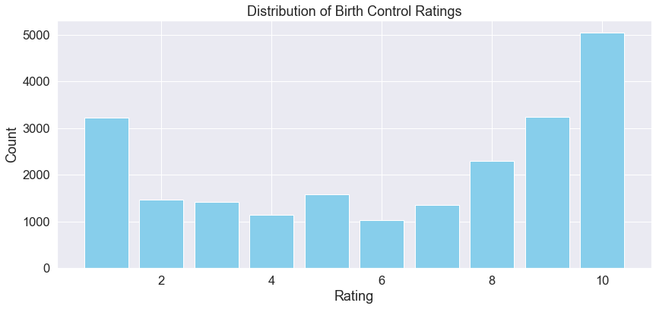
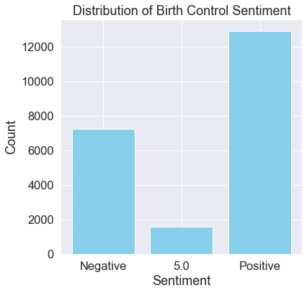

Slide 6
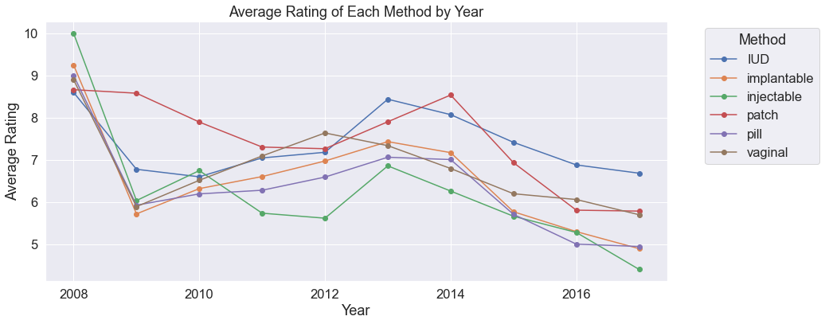

Slide 7
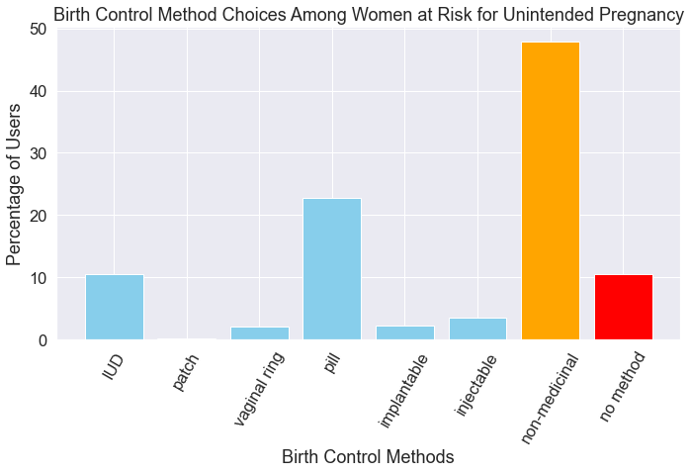
this data from the Guttmacher Institute, 2014

Slide 8
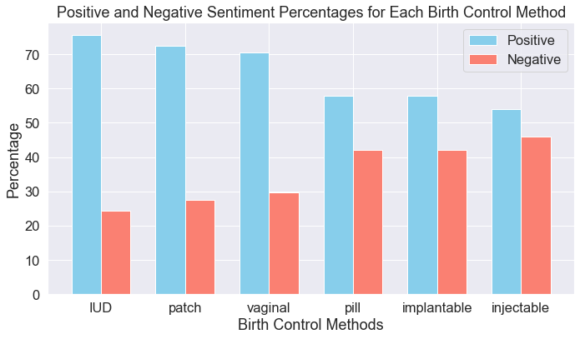

Slide 9
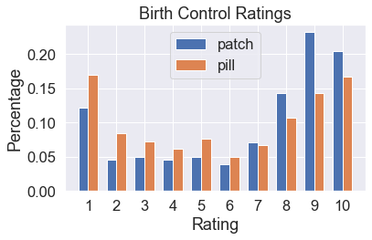

Slide 10
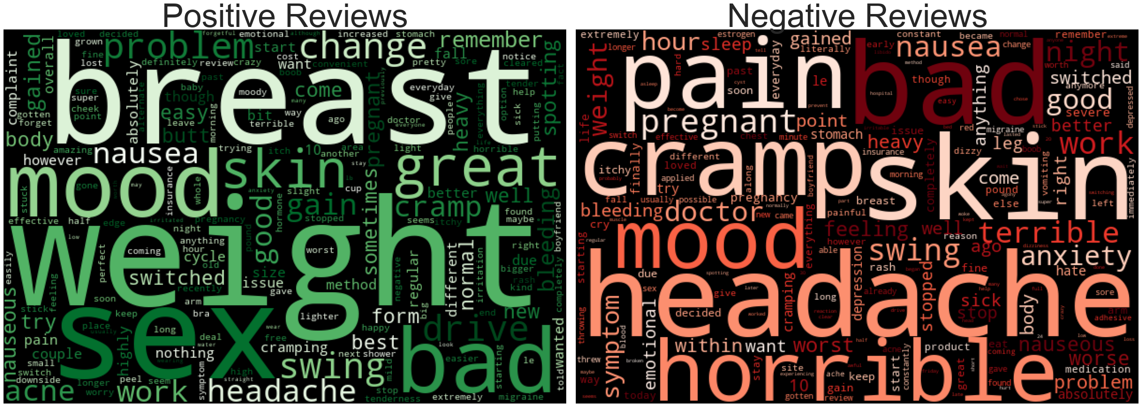
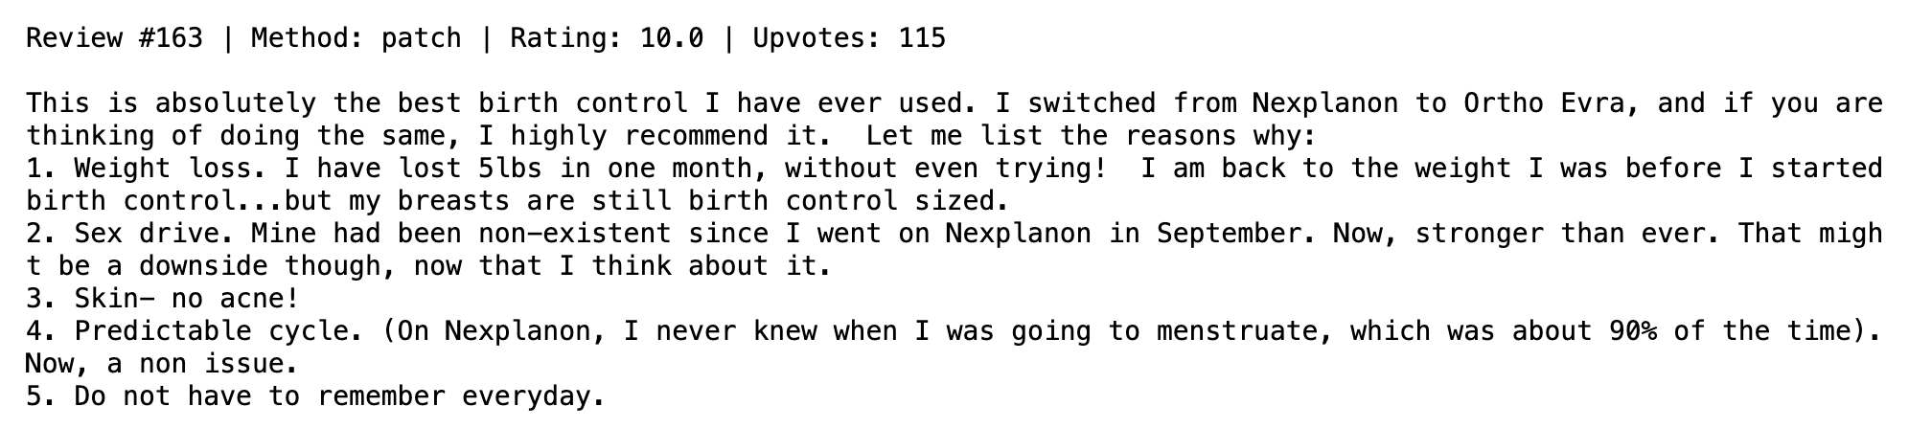
word clouds for patch reviews

Slide 11
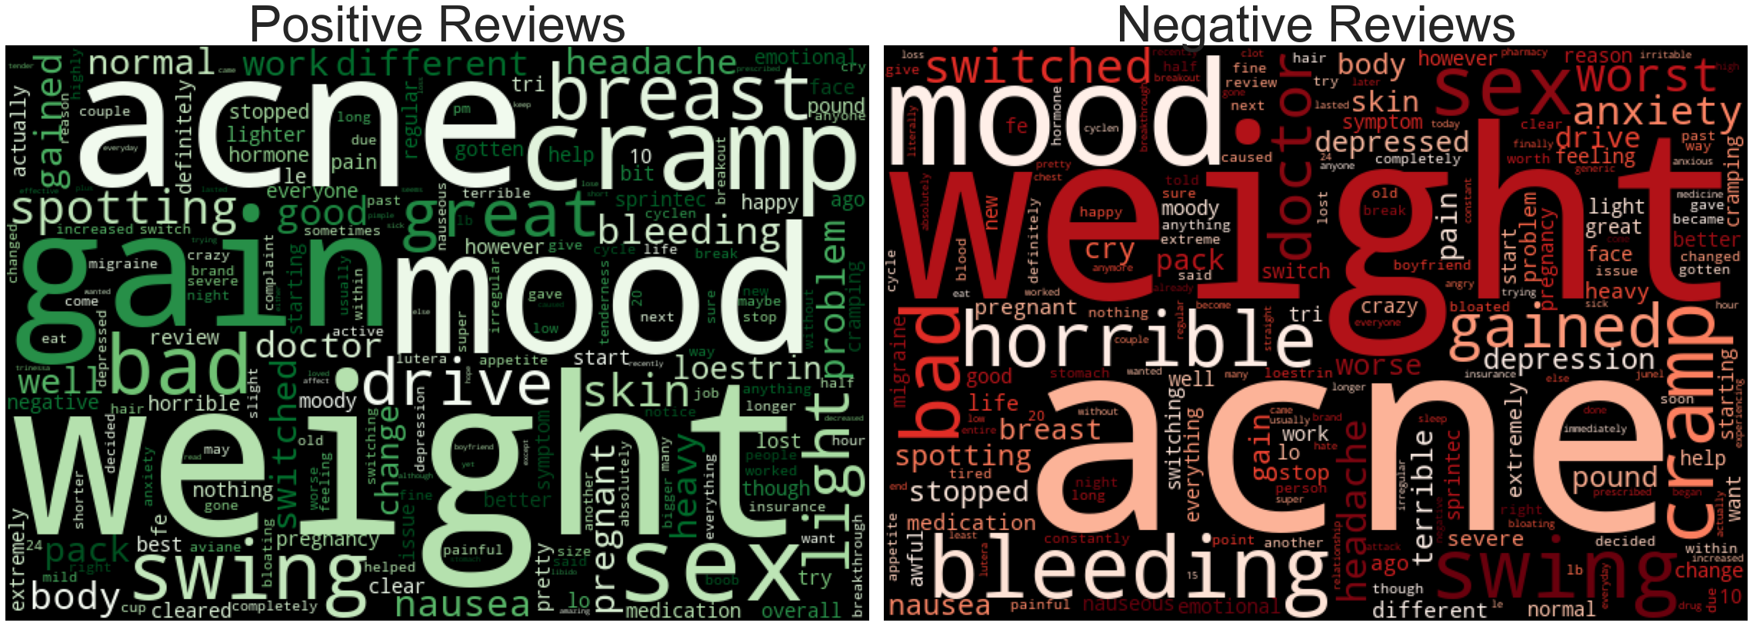
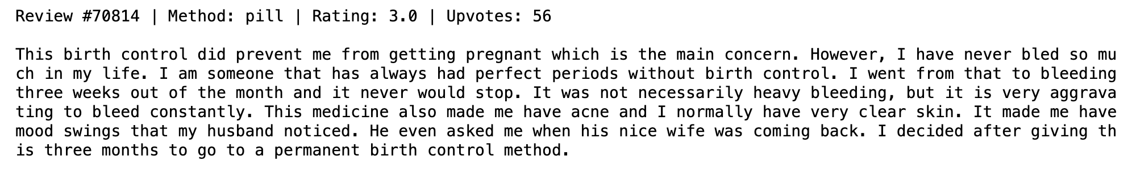
word clouds for pill reviews

Slide 12
Methods
feature creation, e.g. readability scores
ChatGPT3 helped with brand categorization
metrics: F1-macro for method prediction & ROC-AUC for sentiment prediction
ML classifiers: Decision Tree, Random Forest, Logistic Regression*
* final model for both predictions

Slide 13

Model results – METHOD prediction
model | F1-macro | accuracy
Dummy Classifier (BASELINE) | 0.14 | 28.2%
Random Forest | 0.59 | 83.3%
… with hyperparameter tuning | 0.59 | 83.3%
Logistic Regression | 0.87 | 92.1%
… with hyperparameter tuning | 0.90 | 94.2%

Slide 14
Model results – SENTIMENT prediction
model | ROC-AUC | recall | accuracy
Dummy Classifier (BASELINE) | 0.48 | 37.9% | 54.0%
Random Forest | 0.92 | 61.3% | 82.4%
… with hyperparameter tuning | 0.93 | 63.0% | 83.1%
Logistic Regression | 0.93 | 96.0% | 77.2%
… with hyperparameter tuning | 0.95 | 91.3% | 86.3%

Slide 15
Recommendations
abandon injectable
patch as pill alternative
patch has favorable weight and body image effects
apply method and sentiment prediction models to online spaces

Slide 16
Further Inquiry
incorporate upvotes
recommendation algorithm
evidence of reviewers switching brands or methods

Slide 17
Thank you
Aaron Galbraith • 2023
www.linkedin.com/in/aarongalbraith

